Slide 1

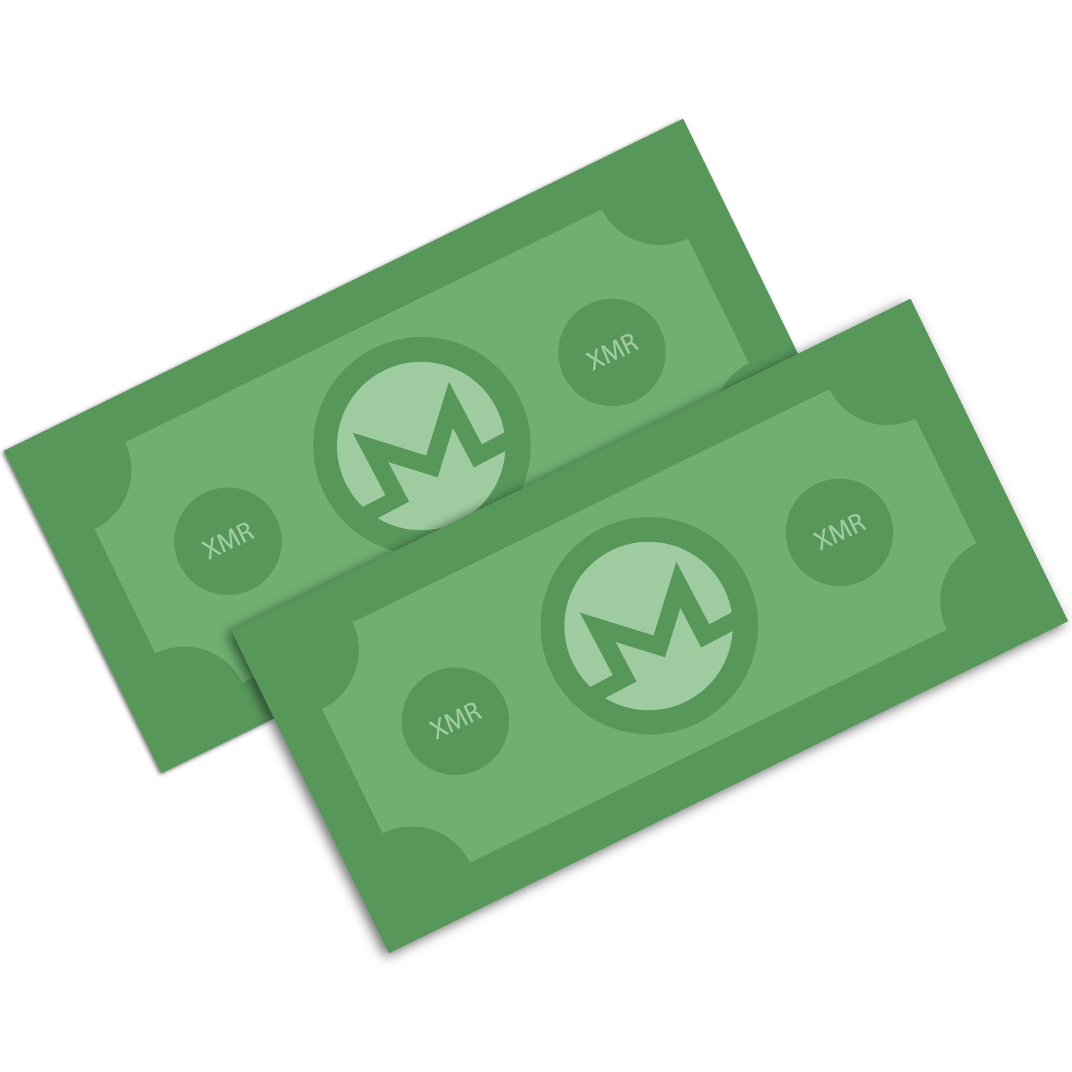
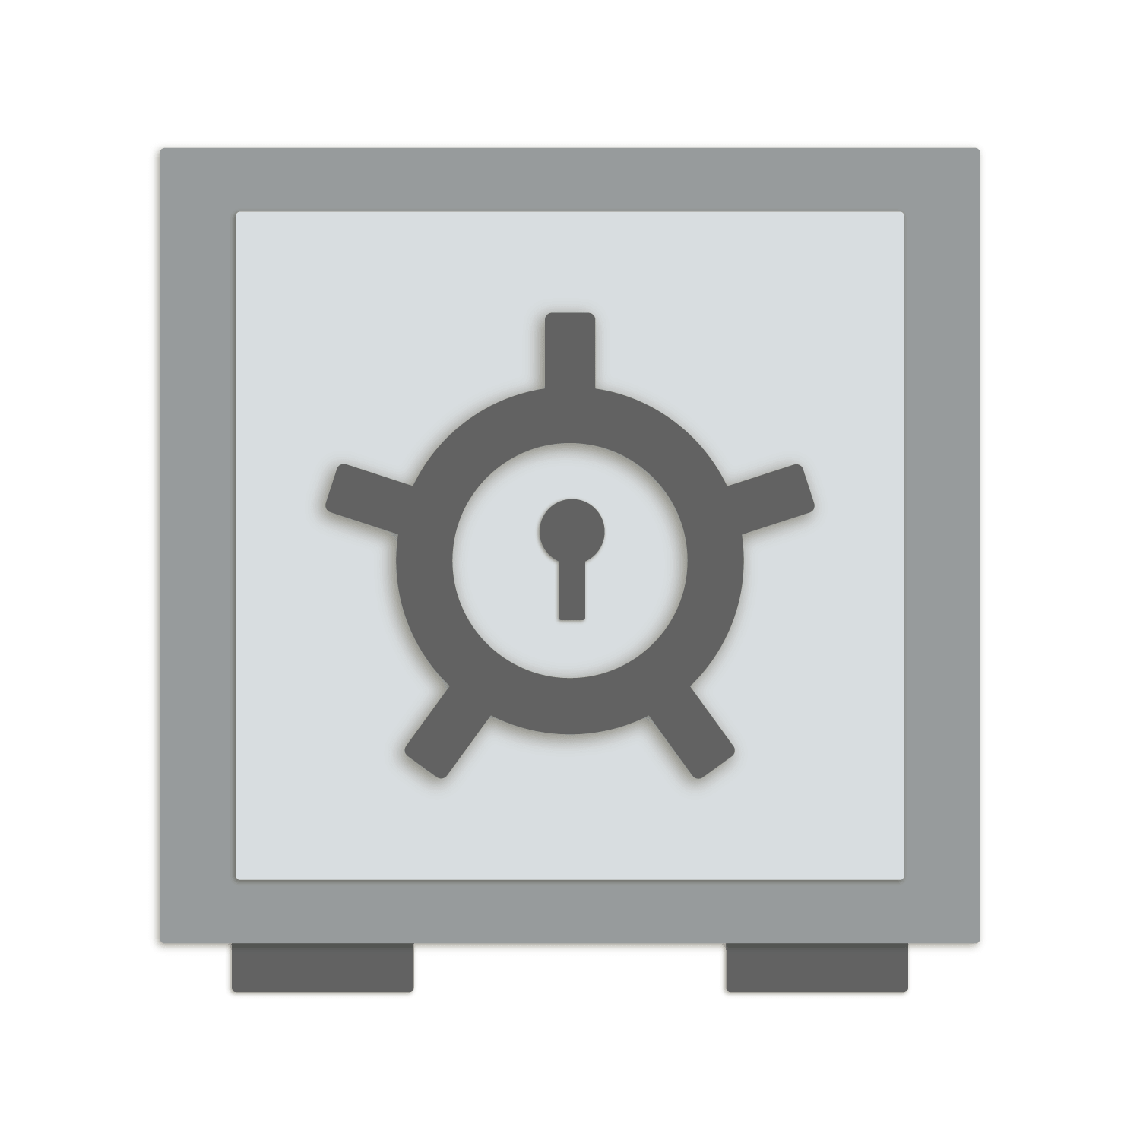

Privacy and Cryptocurrency
By Justin Ehrenhofer

Slide 2

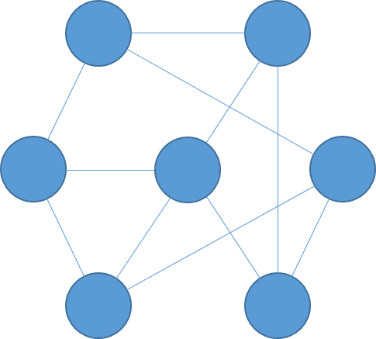
DECENTRALIZED
Older
Newer
BLOCK
Tx ID: wgis85cissajr5da7wz3fcnqnhift
Sender: w3fn5ujfm3d3r975qjd35jrwd4k5q
Receiver: nftic5k8sf4j598wf357jw38956659
Amount: 10 BTC
Notes:
In simple terms, Bitcoin is a decentralized network, where a history of the transactions is stored on thousands of computers around the world. This history is called the blockchain. The blockchain is a chain of blocks. Each block contains the most recent transaction history. There is a new block every 10 minutes. People will ask miners to include their transactions in the next block, often with a fee. The network automatically adjusts so that a new block can be added by one miner at random approximately every 10 minutes. Once a transaction is included in a block, it has a confirmation. People who are very cautious wait for several confirmations, since it is significantly harder to reverse an old transaction than a new one.

Slide 3
Bob
Alice
0.1 BTC
w3fn5ujfm3d3r975qjd35jrwd4k5q
nftic5k8sf4j598wf357jw38956659
Notes:
Everyone can see on the blockchain, that Bob spends 0.1 BTC.

Slide 4
Bob
Alice
0.1 BTC
w3fn5ujfm3d3r975qjd35jrwd4k5q
nftic5k8sf4j598wf357jw38956659
Notes:
This amount will be credited to Alice’s wallet and this transaction is stored forever on the blockchain.

Slide 5
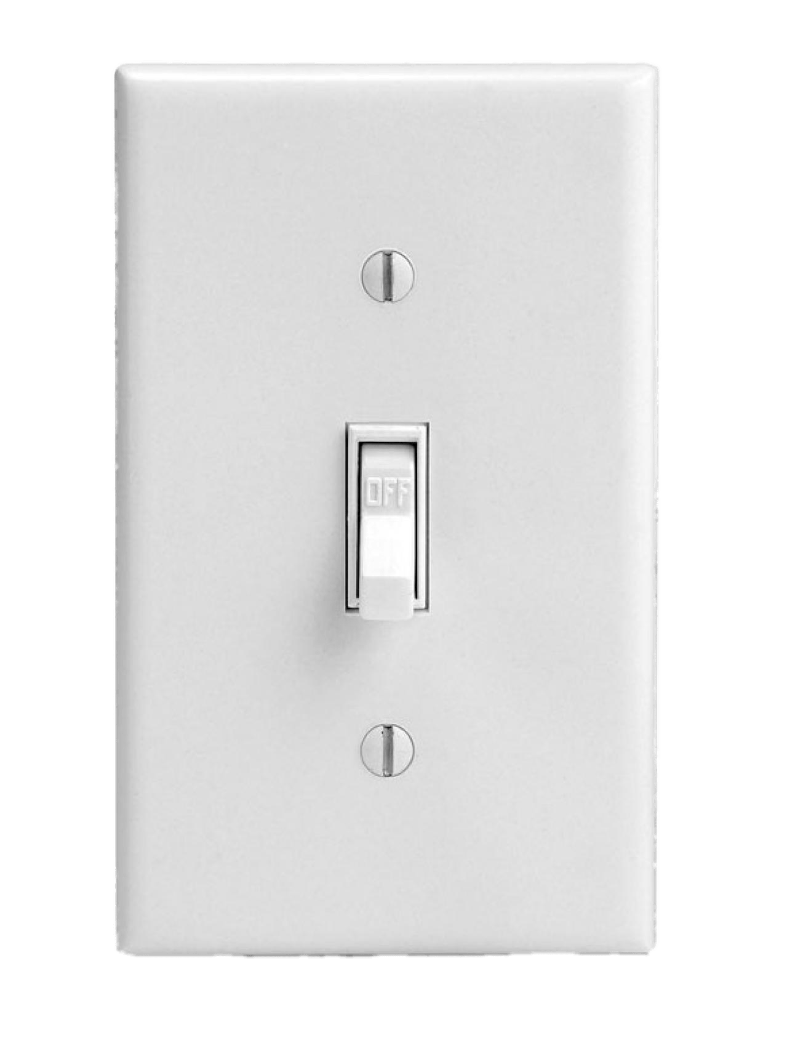
Privacy Isn’t Binary
What most people think privacy is:

Slide 6
Privacy Isn’t Binary
What privacy actually is:
Perfect Privacy
Perfect Transparency

Slide 7
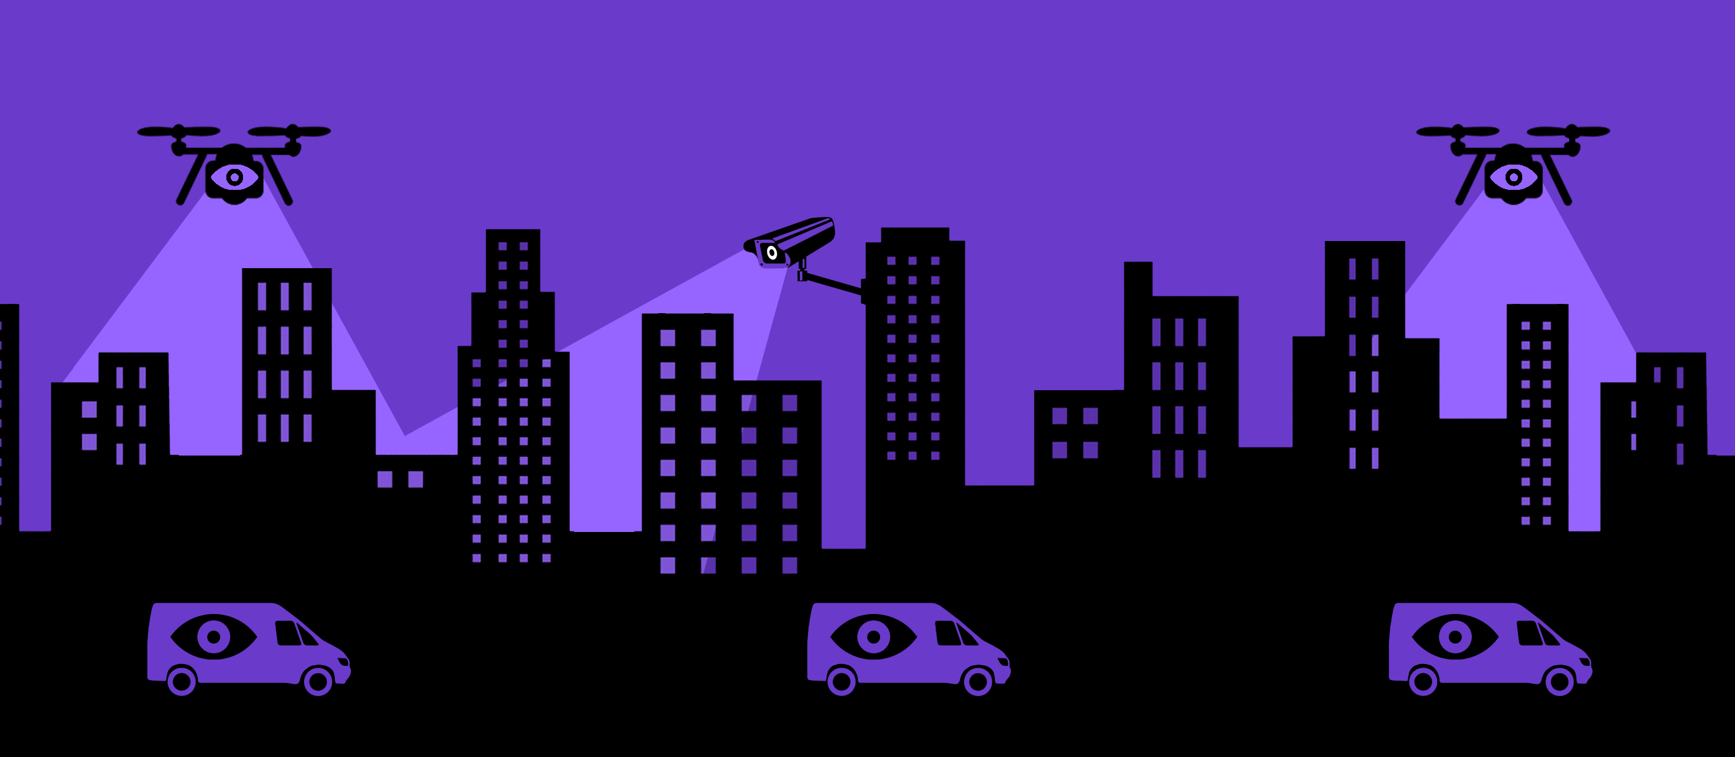
It All Comes Back to a Threat Model
Image courtesy of EFF

Slide 8
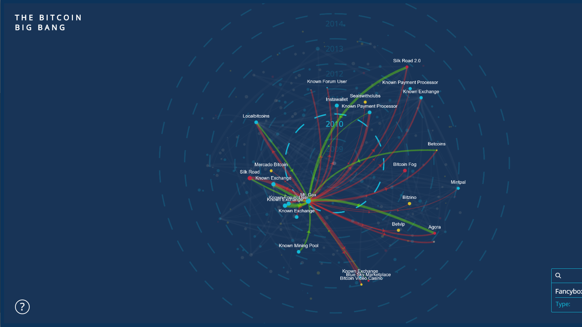

Bitcoin is NOT (very) private!
Notes:
Bitcoin is not private! In fact, it is perhaps the most transparent money system ever made. Everyone in the world can see a history of the following:
The amount of money in a wallet
Where the Bitcoin came from
Where the Bitcoin went
This visualization shows the transfer of Bitcoin from large accounts to others. It is a visual representation of transfers of Bitcoin.

Slide 9




Mixing with other people’s coins
Notes:
When people started realizing that Bitcoin is not private, they tried adding things on top of Bitcoin so some people could have privacy. This is traditionally done with a Bitcoin mixing or CoinJoin approach. Several people take their Bitcoin and send it to a centralized server. This centralized server then gives a random Bitcoin from among those received back to the users. Ideally, this could provide some untraceability, since the origin of the received funds is ambiguous. However, there are several fundamental issues with this type of approach.

Slide 10
Mixing with other people’s coins
Notes:
The vast majority of people who use an optional system that costs extra which you need to go out of your way to use are people who have tainted coins. Tainted coins are coins that are known to previously be used for illicit purposes. An insignificant number of people pay money to mix clean coins. Thus, mixers do not work very well at providing plausible deniability. Instead, they make you stand out, since it makes it look like you are doing something wrong. Mixing itself is a shady act.

Slide 11
Mixing with other people’s coins
Notes:
Second, you add a level of trust to the system. While Bitcoin is trustless, you need to trust the mixer you use with CoinJoin. They may choose to keep a history of the transaction information, and the people who use the service will never know. People must trust that the mixer does not act maliciously, which is a systemic risk with mixing services. In an ideal private system, you should not have to trust anyone else with your privacy.
Finally, from a convenience perspective, it takes a long time to mix coins, since you need to wait for other participants to mix with. If you plan to mix a large number of coins several times, it can take days or weeks. Few users will go through this effort.

Slide 12











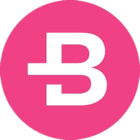

Coins Worth Talking About
Tier: Actual Research and Competence
Tier: Small Modicum of Principles
Tier: Pure Crap

Slide 13
A Quick Dive into Monero
SENDER
AMOUNT
TRANSACTION
BROADCAST
RECEIVER
ɱ
RING
SIGNATURES
RING CONFIDENTIAL
TRANSACTIONS (RINGCT)
KOVRI
(I2P ROUTER)
STEALTH
ADDRESSES
Notes:
Monero is different from a mixing service. It uses three technologies and a work-in-progress fourth technology to provide trustless privacy for all transactions. These technologies work together to protect different parts of a transaction. The sender is hidden with ring signatures. The amount is hidden with ring confidential transactions, or RingCT. The transaction broadcast is not currently hidden without extra steps, but Monero is working on Kovri, an I2P router, to hide this with no additional effort. The receiver is hidden with stealth addresses. All of these technologies will be addressed in this presentation.

Slide 14
A Quick Dive into Monero
5 (Tx ID fgwinw3fwtk54)
5 (Tx ID fgwinw3fwtk54)
8 (Tx ID hng6iwfumwf8)
8 (Tx ID hng6iwfumwf8)
11 (Tx ID twv8mf8dnfas)
11 (Tx ID twv8mf8dnfas)
5hfnq835hng6iwfumwf8
CHANGE
RING SIGNATURE
RINGSIZE 7
13 (Tx ID 7nr8mrjffijdtm)
13 (Tx ID 7nr8mrjffijdtm)
? XMR
3348dqnqcb8vqfi8dfj65f
TO RECEIVER 1
15 (Tx ID wn3f4diiijffwn)
rid8qym234qk34dkwrkh
15 (Tx ID wn3f4diiijffwn)
TO RECEIVER 2
18 (Tx ID n48gfwmfdki)
18 (Tx ID n48gfwmfdki)
21 (Tx ID 4f5f8njdoam4)
21 (Tx ID 4f5f8njdoam4)
Notes:
In summary, for any given transaction, Monero is sent from an ambiguous source, from which an unknown amount is committed and thus an unknown amount is sent, to an unknown receiver or set of receivers. As you can see, all information stored on the blockchain is obfuscated by mandate.

Slide 15
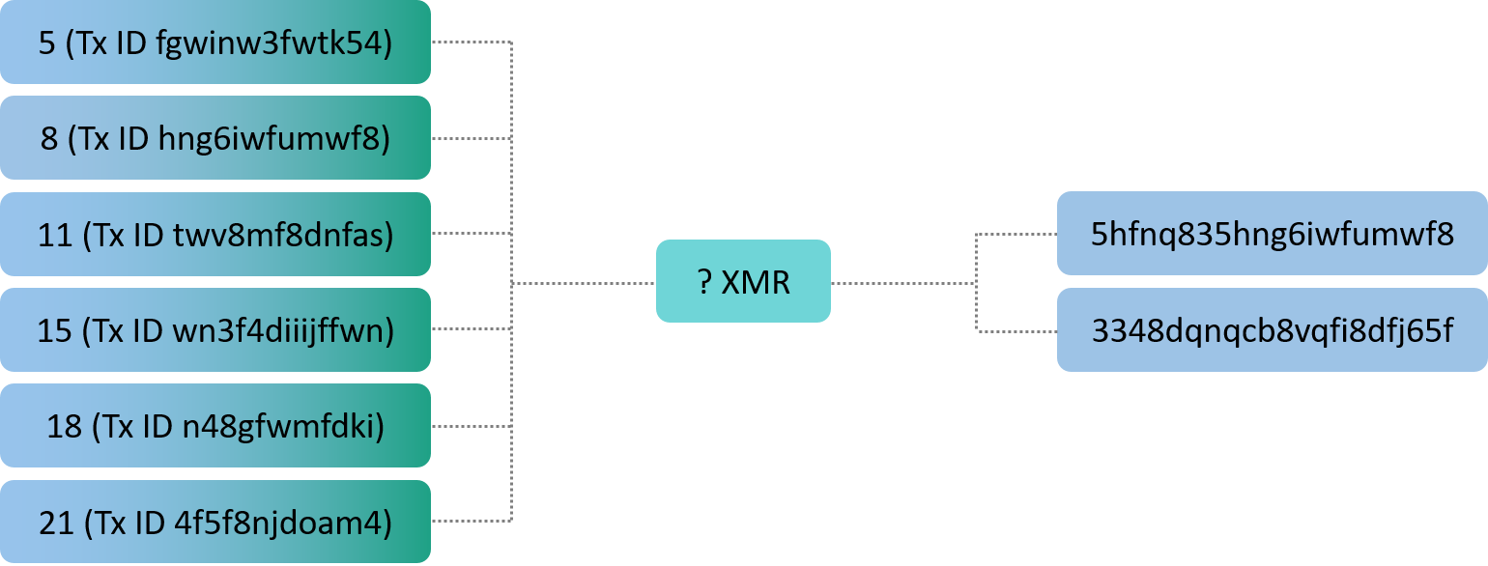
Things Get Complicated Quickly

Slide 16

Summary of Monero

Slide 17
A Quick Dive into Zcash
SHIELDED

Slide 18

Zcash Transaction Types
(BLACK BOX)
(BLACK BOX)
(BLACK BOX)
x
Fully-shielded
Partially-shielded
Transparent
Sending from one z-address to another z-address
Sender, receiver, and amount hidden with zero-knowledge proofs
<0.5% of transactions in the past month
These theoretically provide greater untraceability than Monero
Sending from one z-address to a t-address or vice versa
Sender OR receiver hidden
Amount visible
<10% of transactions in the past month
Sending from one t-address to another t-address
Sender, receiver, and amount visible, just like Bitcoin
>90% of transactions in the past month
https://explorer.zcha.in/statistics/usage

Slide 19


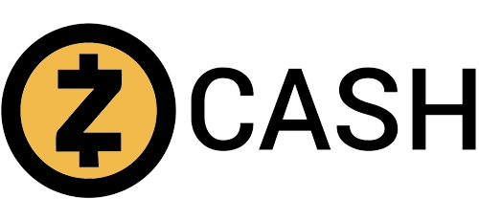
Mandatory Privacy Matters
Total transactions in the past month
180,000
270,000
183,000
% of transactions using privacy features
100%
<1%¹
<10%/<0.5%
Number of private transactions
180,000
<2,700
~18,000/~1,000
Notes:
¹https://dashpay.atlassian.net/wiki/spaces/OC/pages/79986710/Messaging+Framework+for+Dash

Slide 20
Privacy Concerns
Ring signatures
Transaction amount
T-addresses
Non Z->Z transactions
Timing analysis
Metadata
Transaction broadcast
User behavior

Slide 21
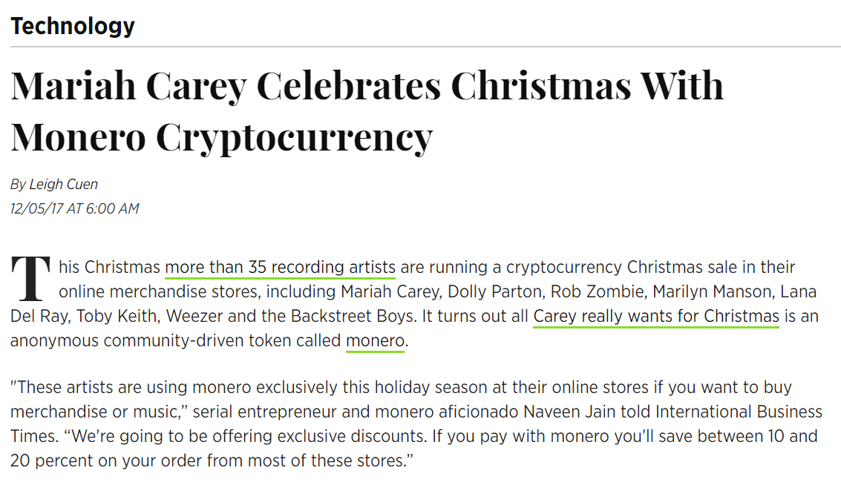
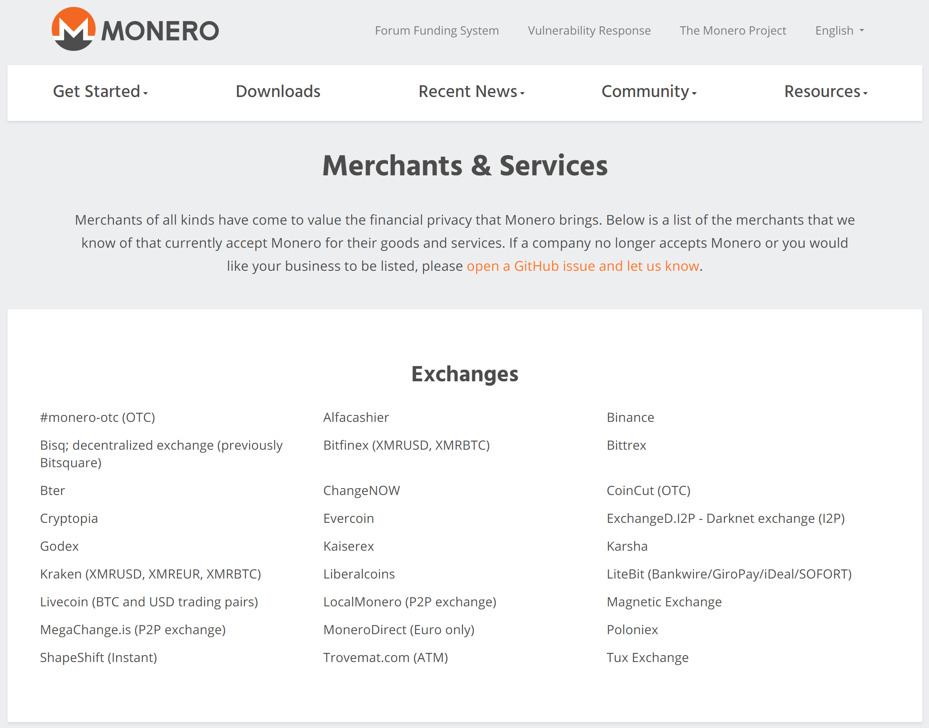
Myth: Cryptocurrency is Only Used for Drugs
Between 0-25% of Monero transactions were deposits on AlphaBay¹
People thought Bitcoin was used for illicit purposes, but this has fallen out of the news as people realize there are other use-cases.
You want privacy for many reasons, not just illicit purposes.
Notes:
1. https://arxiv.org/pdf/1704.04299.pdf

Slide 22
Myth: I Don’t Need Privacy

Slide 23
Myth: Governments will Ban Privacy

